Slide 1
GANime
Generative Adversarial Networks In Motion Entertainment
Matt Yancey 2022
Notes:
Thank you
Excited to share
Still a work in progress and looking forward to feedback
Chose to share this because it’s a personal project - no conflict of sharing and it’s recent
Title - GANime

Slide 2


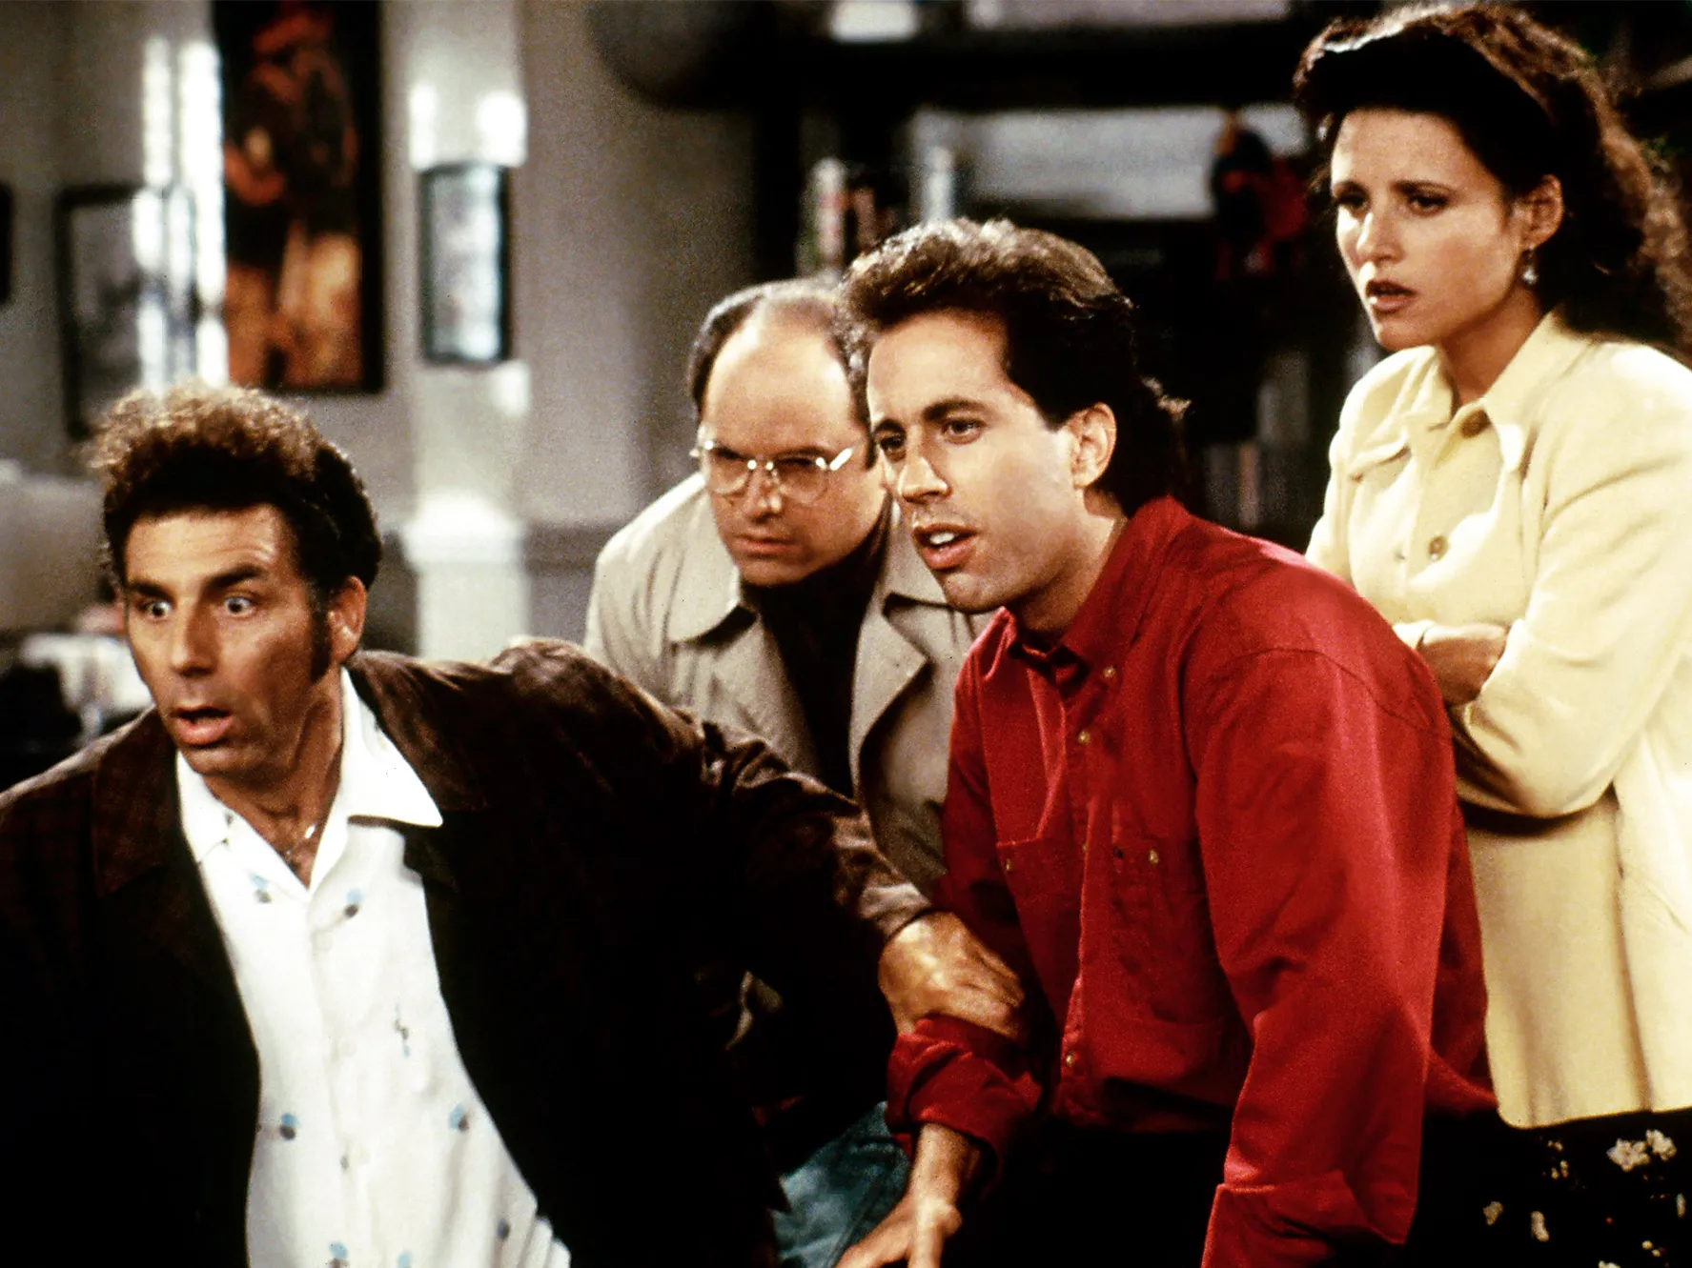
Are black bars intruding on your nostalgia?
Watching Then
Watching Now
Notes:
What are we trying to do
90-00s
Pilarboxes
4:3 to 16:9
What can we do about it

Slide 3
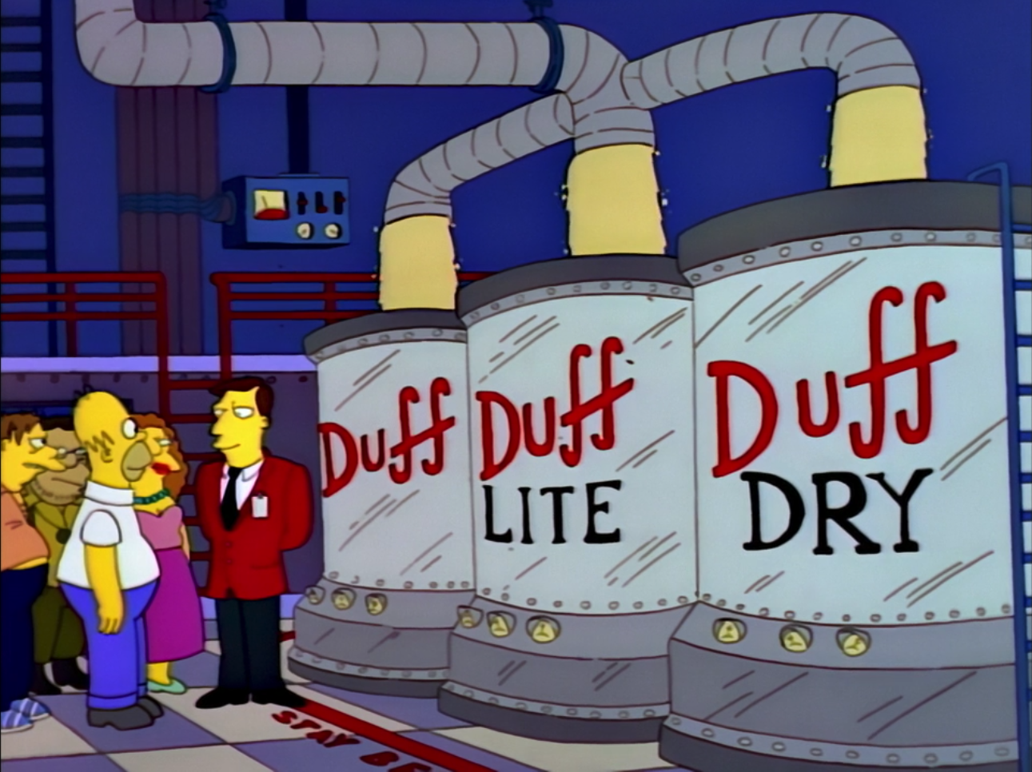
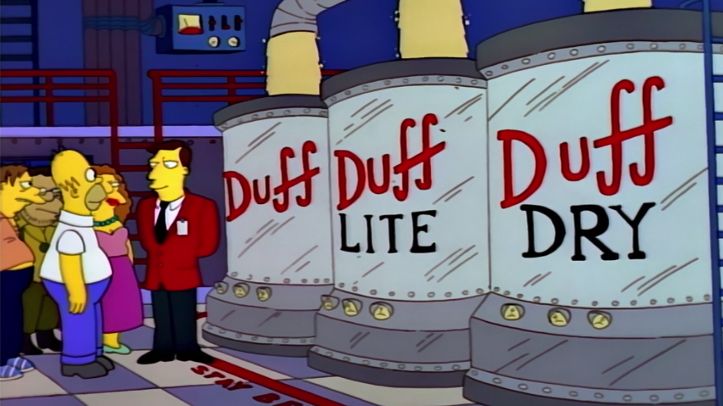

Current 16:9 Transformation Solutions
Subtractive
Crop and zoom
Original
Disney’s Simpsons Remastering
Additive
Pillarboxing with echo
Notes:
Crop and zoom
Disney’s remastering of the simpsons
Pillarboxing with echo
News Stations tend to use
Computer Vision

Slide 4

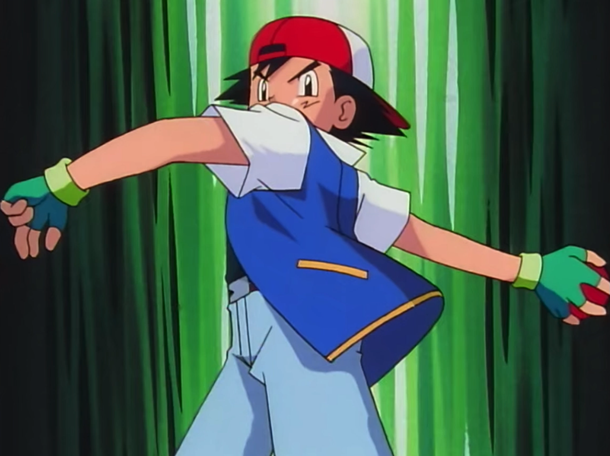
GANs and Image Inpainting
GANs have been found to be effective at image inpainting
Can we train a GANs model to convert video from a 4:3 aspect ratio to 16:9 by imputing the area on the sides of the frame?
GANs Model
4:3 Aspect Ratio
16:9 Aspect Ratio
Notes:
GANs have had a good track record for the last 6 years
The field is image inpainting
Photo restoration
Photo shopping
Can I use gans to restore my childhood memories

Slide 5
Purpose and Roadmap
Explore the effectiveness of GANs in video inpainting
Gain an understanding of past and current work in the field by creating three models based on the following papers:
Context Encoders: Feature Learning by Inpainting (Pathak, Krähenbühl, Donahue, Darrell, Efros) CVPR 2016
Globally and Locally Consistent Image Completion (Iizuka, Simo-Serra, Ishikawa) ACM Transactions on Graphics 2017
Resolution-robust Large Mask Inpainting with Fourier Convolutions - LaMa (Suvorov, Logacheva, Mashikhin, Remizova, Ashukha, Silvestrov, Kong, Goka, Park, Lempitsky) WACV 2022
Notes:
To explore that question roadmap
Purpose of the project it two fold
Convert
Understanding of the techniques used in the field
High level review of the literature found 3 papers to do a deep dive on
Experiment with their methodology, cannibalize what works and move on the to next
Missing deepfillv2
See a progression of the results

Slide 6

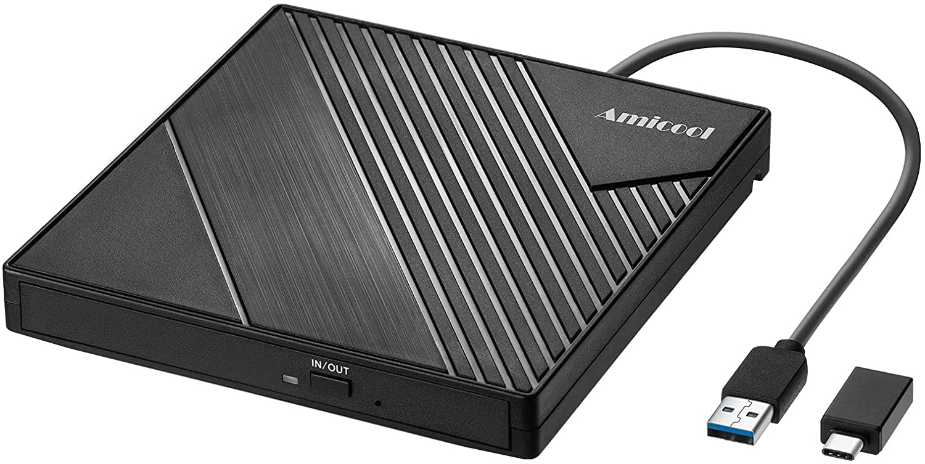
Project Scope
Simplify the domain
Pokemon!
Contains seasons in 4:3 and 16:9 aspect ratio
Data set
2 seasons of 16:9 Pokemon
64 episodes
21 Hours
Saving every 4th frame (~600k frames)
Data Split
Train 70% (420k)
Validate 20% (120k)
Test 10% (60k)
Image size:
512:288 = 16:9 x 2⁵
Frequently bought together by data scientists
Notes:
Simplify the problem
Not everything from Signfiled to the simpons
Animation has consistent style and simplified color pallet
Keep the tradition of having GAN models have gans in the model name
StyleGAN
DiscoGAN
Need something that has data in 16:9 format to train on

Slide 7

Project Feasibility (Pros and Cons)
Lower Number of Examples
Places2 (8 million) and CelebA HQ (30,000)
Less Training Time
Most papers train for months
Specific domain
Consistent art style
Simplified color pallet
Specific Masks
Only modeling to fill in information on the edges
Notes:
Most image inpainting models train on Places2 and CelebA
Simplified the area I’m aiming to restore

Slide 8
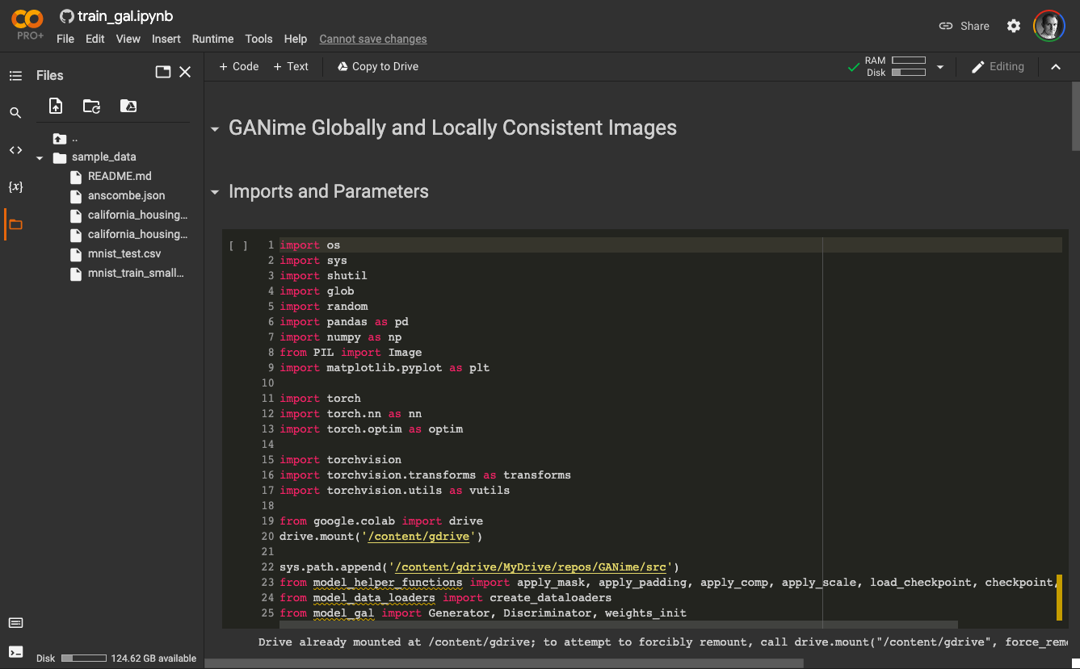
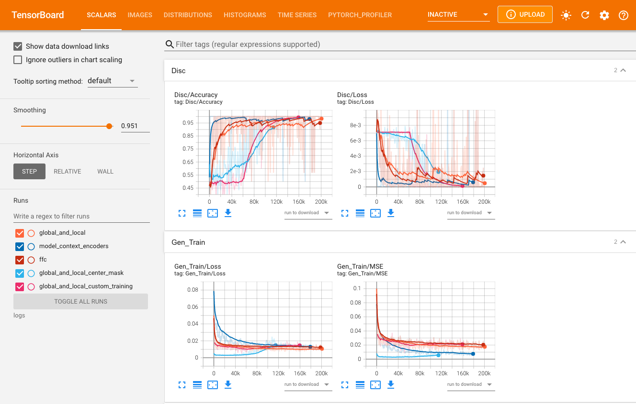

Tech Stack
Machine Learning Framework
PyTorch
Platform
Google Colab Pro+
NVIDIA Tesla V100 ~7.5 Teraflops
Logging and Monitoring
TensorBoard

Slide 9
GANs Overview
Real Data
Generative Adversarial Nets (Goodfellow, Pouget-Abadie, Mirza, Xu, Warde-Farley, Ozair, Courville, Bengio) Advances in neural information processing systems 2014
Applications include:
Image inpainting
Celebrity face generation
Super resolution
Art generation
Discriminator
Loss
Generator
Fake Data
Notes:
Ian Goodfellow 2014
2 player system
Nash equilibrium

Slide 10

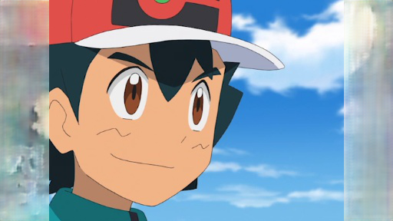
Image Inpainting Application of GANs
Apply Mask
Generator
Discriminator
Loss

Slide 11
Other Work in Video Inpainting
Deep Flow-Guided Video Inpainting (Xu, Li, Zhou, Loy) CVPR 2019
FlowNet 2.0: Evolution of Optical Flow Estimation with Deep Networks (Ilg, Mayer, Saikai, Keuper, Dosovitskiy, Brox) CVPR 2017
Notes:
Flow guided and pixel propagation

Slide 12
Model v1
Context Encoders: Feature Learning by Inpainting

Slide 13
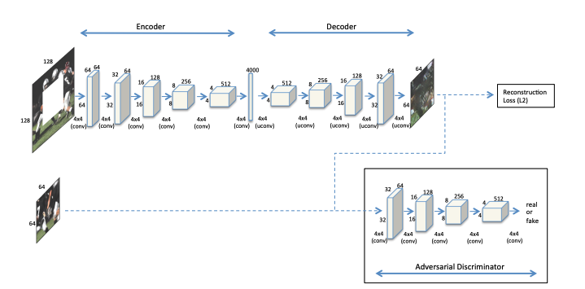
Context Encoders - Model Overview
Model Overview
Encoding images to a 4000 feature space
Decode to only the cropped area
Optimizer: Adam
Learning Rate
Gen: 1x10⁻³
Disc: 1x10⁻⁴
Total_{Loss} = MSE_{Loss} + ɑAdv_{Loss}
ɑ Weight: 0.001 (10 to 1 ratio)
Data
Image input size 128x128
Pascal Voc dataset
Trained on > 6 Million
Notes:
2016
Encoding to 1x4000 feature space
Decoding to the missing area
Have standard masks
The combination of MSE and adversarial loss help keep results similar to the desired output and unique

Slide 14
Model Adaptation v1
Model Overview
Input size is 512 x 288
Customize the kernel and strides values of convolution layers
Decoding to the full image
Discriminator
Same architecture as the Generator’s encoding
Feeds into a linear layer and a Sigmoid layer for predictions
Data
Trained on ~3 million (6 million)
Encoding
Decoding
16 x 9 x 512
16 x 9 x 512
1 x 4000
Convolutional x 5
Kernel 4 Stride 2
Transpose Convolutional
Kernel 16x9 Stride 1
Convolutional Layer
Kernel 16x9 Stride 1
Transpose Convolutional x5
Kernel 4 Stride 2
Convolutional Layers include batch normalization and ReLU activation functions.
Notes:
Encoding section where I’m reducing the image size but increasing the number of features
Because my images are not square, be creative with kernels
Decoding to the full image
Training is smaller
In playing with kernels
Going back to creative convolution

Slide 15

The Importance of Kernel, Stride, and Padding
Kernel: 3, Stride: 2, Padding: 0
Can result in silent failures
Solutions
Fixed image sizes and kernel settings
Reflection padding
“Same” padding (TensorFlow)
Step 1
Step 2
Step 3
Convolution is skipped because the kernel does not fit
Notes:
Skipping part of the image will no raise an error or warning
Do I need a generator for each side
Model results

Slide 16
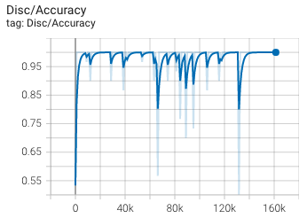
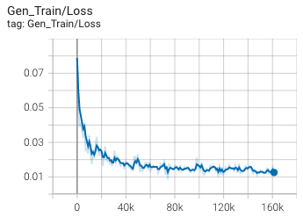
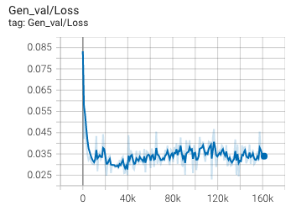
Results - Metrics on training and validation data
Discriminator Dominance
Notes:
Could at a dropout rate to the feature space layer

Slide 17

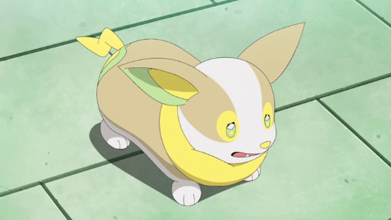
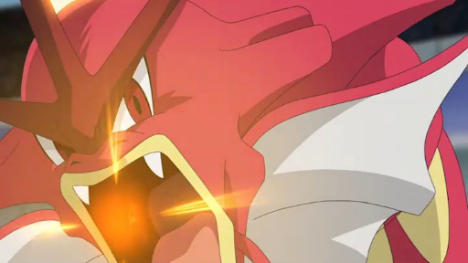

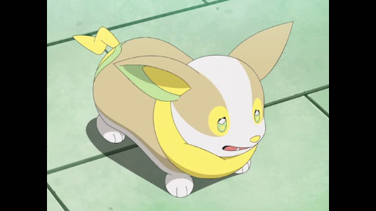
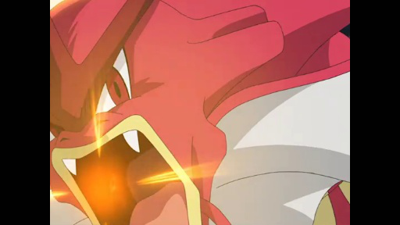
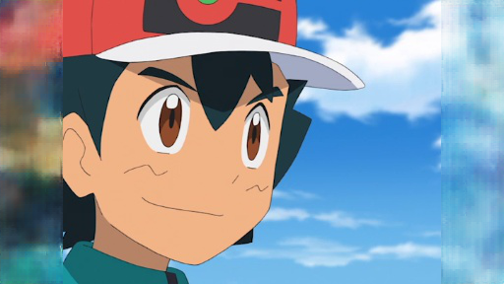

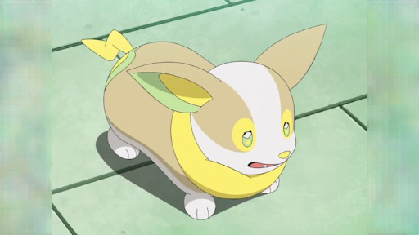
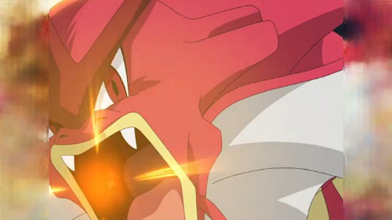
Results - Visual Inspection on Validation Samples
Input
Masked
Model Output
Notes:
Primarily giving a blurred effec that gets more dithered as we go out
Not amazing but I good for a v1 of the model

Slide 18
Model v2
Globally and Locally Consistent Image Completion

Slide 19
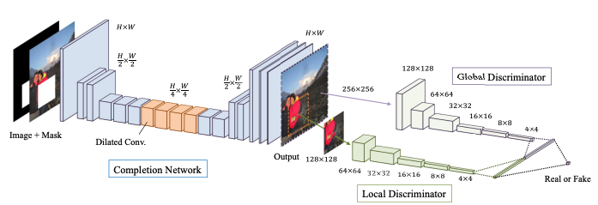
Globally and Locally Consistent Images Encoders
Model Overview
Uses two discriminators
Asymmetric training
Gen 90,000 iterations
Disc 10,000 iterations
Both 500,000 iterations
Dilated Convolutions
Optimizer: AdaDelta
ɑ Weight: 0.0004
Data
Places2 (8 millions images)
Trained on > 57 Million images
Notes:
3 key ideas
2 discriminators My previous model was only looking at the entire image
Asymmetric training
Trained on 57 million images (prev was 6 million)

Slide 20
Dilated Convolutions
Expanding the kernel to gain more context
3 by 3 Kernel with dilation of 1
3 by 3 Kernel with dilation of 2
3 by 3 Kernel with dilation of 3
Notes:
Critical with large masks (64 pixels)

Slide 21
Model Adaptation v2 - Generator
Model Overview
Generator
Uses convolutional layers for both downsampling and feature building
Asymmetric training
9 to 1 training of the generator vs discriminator
Discriminator
2 passes to the discriminator
Data
Trained on ~3 million vs 57 million
Progressive Dilated Convolution Layers
Encoding
Decoding
Convolutional x 6
Output size 128x72
Transpose Convolutional x 6
Dilated Convolutional Layer
Kernel 3
Stride 1
Dilation (2, 4, 8, 16)
Notes:
Back and forth training of 9 to 1 do have a

Slide 22
Model Adaption v2 - Discriminators
Global Discriminator
Linear Layer & Sigmoid
Global Image
Loss
Local Discriminator
Left Local
Right Local
1024 * 3
Feature Space
Notes:
Unique thing about the project is that I have two constant masked sections

Slide 23
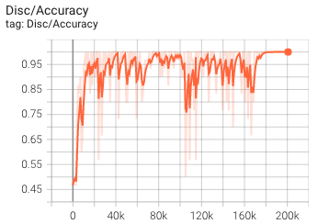
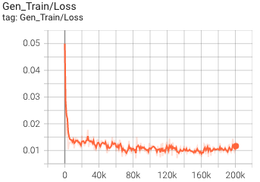
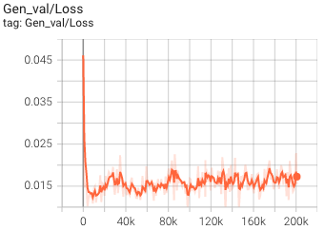
Model v2 Metrics
Notes:
See better discriminator accuracy

Slide 24

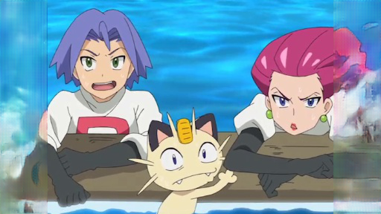
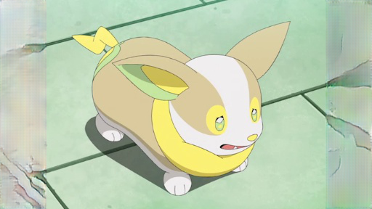
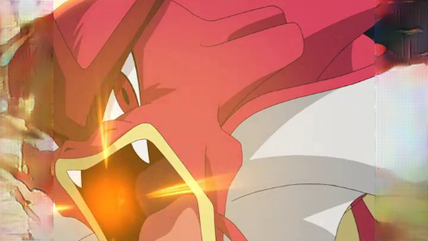
Results - Visual Inspection of Validation Samples
Input
Masked
Model Output
Notes:
Black outline of shapes
Recognizes direction and pattern

Slide 25
Model Comparison
Model v1
Model v2

Slide 26
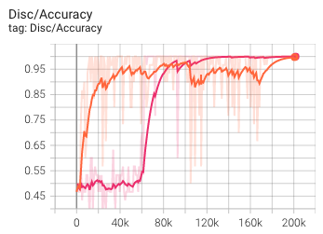

Model v2.5 - Modified Training Schedules
Training
Generator Solo Training: 90k iterations
Discriminator Solo Training: 10k iterations
Both after 100k
Still see discriminator dominance
Image output is worse
Model v2
Global and Local Model
Modified Training Schedule
Model v2.5
Notes:
Address the training schedule
Trading off between discriminator and gen in a 9:1 ratio

Slide 27
Model v3
Resolution-robust Large Mask Inpainting with Fourier Convolutions (LaMa)
Notes:
LaMa sounds better than FoCo

Slide 28
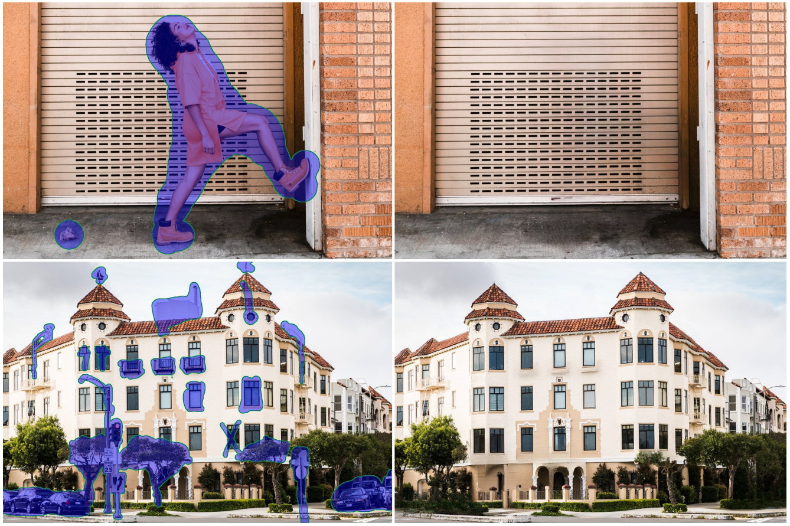
The LaMa Model
Model Overview
Key improvements over previous methods
Improved masks generation
Fast Fourier Convolutions* to gain global context of the image
Robust loss function
Data
Places and CelebA HQ datasets
Trained on more than 30 million images
Benefits
Generalizes at high resolutions (2k) even though trained on 256x256
Pattern recognition
*Fast Fourier Convolution (Chi, Lu and Jiang, Borui and Mu, Yadong) Advances in Neural Information Processing Systems 2020
Notes:
Latest and grates in image inpainting (published just last month)
Samsung AI
3 key improvements
Improved mask generation
FF Breaks down images or sound into wave decomposition. This type of transformation is used in compression, jpeg
Now instead of values in our tensor representing a pixel value it represents what the general wave patters are and how does this location deviate from that.
Robust loss function that has 4 different terms
No local discriminator - I’m going to leave min in

Slide 29
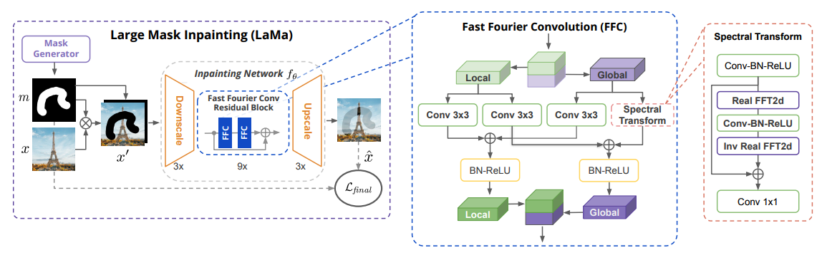
Resolution-robust Large Mask Inpainting with Fourier Convolutions

Slide 30
Loss Function
The inpainting problem is inherently ambiguous. There could be many plausible fillings for the same missing areas, especially when the “holes” become wider.
(Suvorov et al.)
High receptive field perceptual loss
MSE requires the generator to reconstruct the image exactly
Perceptual loss compares feature spaces
Adversarial loss
Helps with generating natural-looking results
Adversarial perceptual loss
Stabilizes training
Gradient penalty
Improves generalization of the discriminator
L_{final} = ϏL_{adv} + αL_{HRFPL} + βL_{DiscPL} + ⍴R1
Notes:
Use ResNet50 VGG19
Abandoning the MSE loss

Slide 31
Model Adaptation v3
Fast Fourier Layers
Model Overview
Testing with 9 Fast Fourier Convolution Layers
Cost function and discriminator remain the same as previous model
Data
Trained on ~3 million vs 30 million
Progressive Dilated Convolution Layers
Encoding
Decoding
Convolutional x 3
Output size 128x72
Transpose Convolutional x 3
Output size 512x288

Slide 32
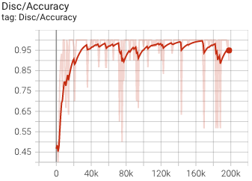
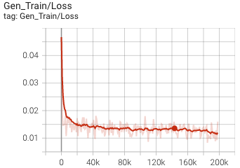
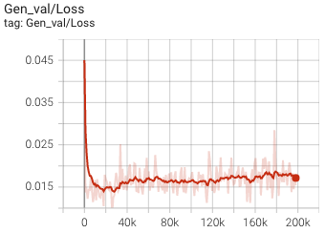
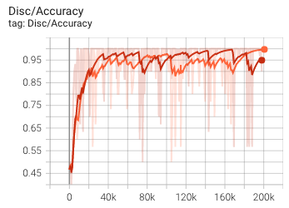
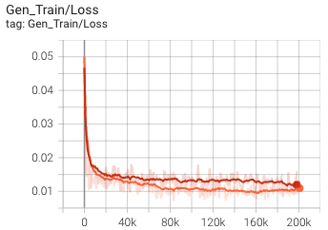
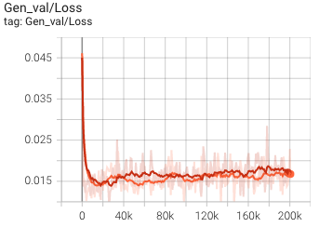
Model v3 Metrics
Model v3
Model v2 and v3
Notes:
Came out last month

Slide 33
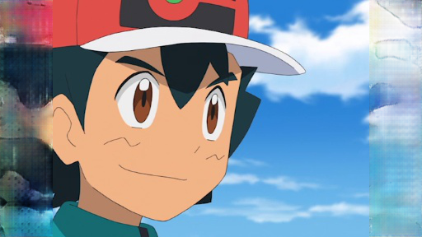

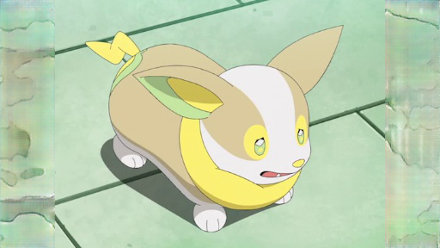
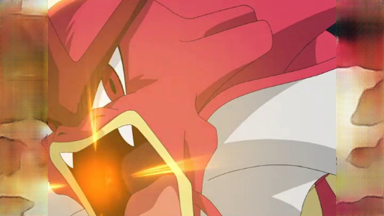
Model Comparison
Model v1
Model v2
Model v3
Notes:
Switching to the full Lama
Using the training script from the project GitHub Repo
Control over
Starting from zero, no transfer learning
Training data
Mask generation
Iterations (3 millsion)

Slide 34
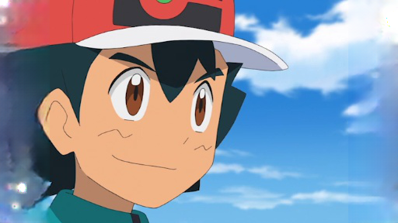

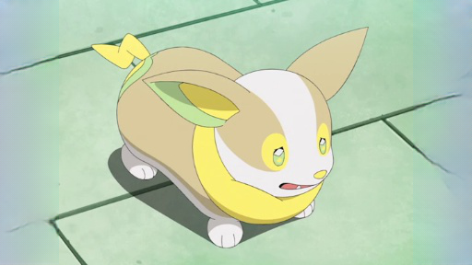
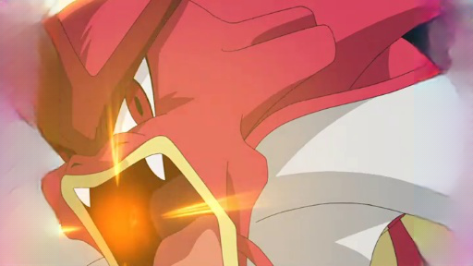
Model Comparison
Model v1
Model v2
Model v3
Model v3.5
Notes:
LaMa has less distortion at the ends of the the image when there is a pattern

Slide 35
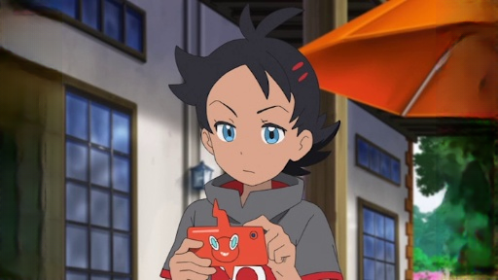
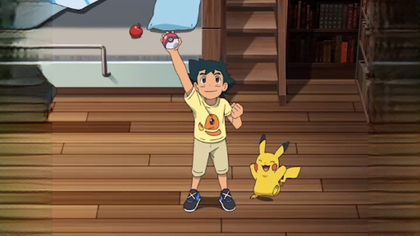
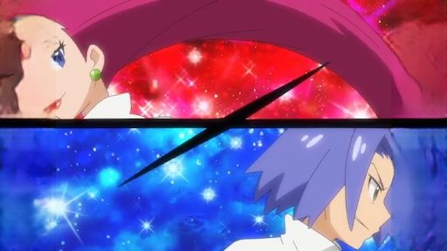
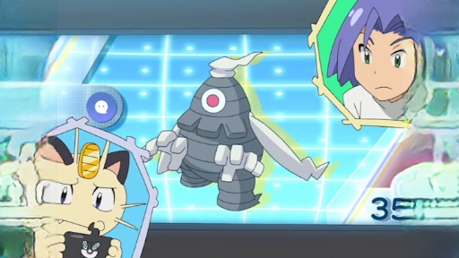
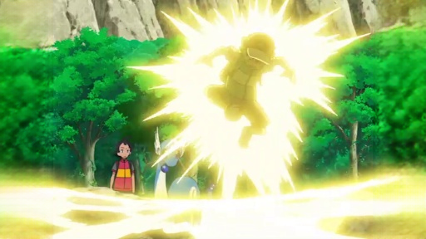

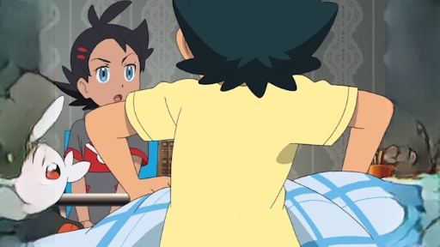
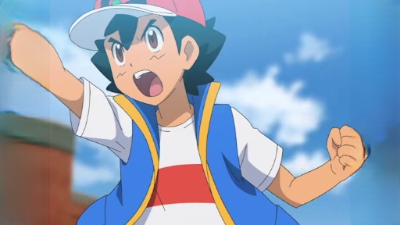
Results may vary
Successful Examples
Unsuccessful Examples
Notes:
Results still vary

Slide 36
How do we compare models?
Challenges
Models have unique cost functions
MSE over values blurry results
The multiple solutions problem
Solutions
Frechet Inception Distance (FID)
Learned Perceptual Image Patch Similarity (LPIPS)
Loss is calculated on the difference of feature vectors and not pixels
Feature vectors are created using pretrained models (Inception V3)
A pretext problem on which the base network for a perceptual loss was trained is important. For example, using a segmentation model as a backbone for perceptual loss may help to focus on high-level information, e.g. objects and their parts. On the contrary, classification models are known to focus more on textures [10], which can introduce biases harmful for high-level information.
Notes:
How do we empirically compare the models?
They call out the importance of the model that is generating the features
Classification models are known to focus on textures

Slide 37
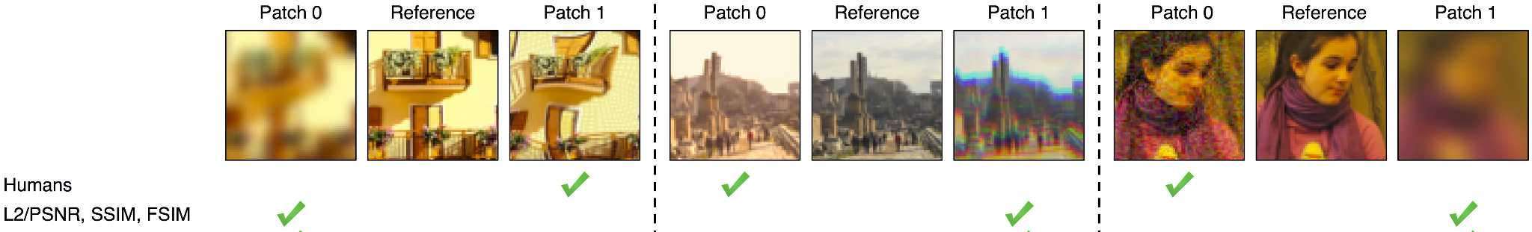
Learned Perceptual Image Patch Similarity (LPIPS)
The Unreasonable Effectiveness of Deep Features as a Perceptual Metric (Richard Zhang, Phillip Isola, Alexei A. Efros, Eli Shechtman, Oliver Wang) CVPR 2018

Slide 38
Lpip scores on the Testing Data
v1
v2
v3
v3.5
Human Ranking
4 | 2 | 3 | 1
4 (0.146) | 3 (0.139) | 2 (0.137) | 1 (0.099)
LPIPS score
(lower is better)

Slide 39
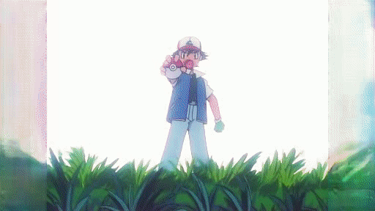





Putting it all together
Model v2
Model v3.5
Notes:
Lama generalies more to other domains

Slide 40
Future work
Takeaways
Global and local discriminators
Asymmetric training helps abate discriminator dominance
Advanced loss functions help generators
Fourier ResNet has strong results with patterns but struggles with characters
Next Steps
Data
Expand training data
Clean the data
674 episodes in 16:9 (used only 64)
More training
Hyper parameter tuning
Address temporal consistency
Find or build a pokemon model to use for calculating perceptual loss
Notes:
Global and local discriminators work well, probably because I have fixed masks

Slide 41
Thank You
Questions

Slide 42
Appendix

Slide 43
Model Architecture and Output Sizes - Context Encoders
 | kernel size | stride | padding | width | height
Input | NA | NA | NA | 512 | 288
Layer 1 Output | 4 | 2 | 1 | 256 | 144
Layer 2 Output | 4 | 2 | 1 | 128 | 72
Layer 3 Output | 4 | 2 | 1 | 64 | 36
Layer 4 Output | 4 | 2 | 1 | 32 | 18
Layer 5 Output | 4 | 2 | 1 | 16 | 9
Layer 6 Output | 16x9 | 1 | 1 | 1 | 1
TLayer Output | 16x9 | 1 | 1 | 16 | 9
TLayer 1 Output | 4 | 2 | 1 | 32 | 18
TLayer 2 Output | 4 | 2 | 1 | 64 | 36
TLayer 3 Output | 4 | 2 | 1 | 128 | 72
TLayer 4 Output | 4 | 2 | 1 | 256 | 144
TLayer 5 Output | 4 | 2 | 1 | 512 | 288

Slide 44
Model Architecture and Output Sizes - Global and Local
 | kernel size | stride | padding | width | height | dilation
Input | NA | NA | NA | 512 | 288
Layer 1 | 5 | 1 | 2 | 512 | 288 | 1
Layer 2 | 4 | 2 | 1 | 256 | 144 | 1
Layer 3 | 3 | 1 | 1 | 256 | 144 | 1
Layer 4 | 4 | 2 | 1 | 128 | 72 | 1
Layer 5 | 3 | 1 | 1 | 128 | 72 | 1
Layer 6 | 3 | 1 | 1 | 128 | 72 | 1
dilated | 3 | 1 | 1 | 128 | 72 | 2
dilated | 3 | 1 | 1 | 128 | 72 | 4
dilated | 3 | 1 | 1 | 128 | 72 | 8
dilated | 3 | 1 | 1 | 128 | 72 | 16
Layer 11 | 3 | 1 | 1 | 128 | 72 | 1
Layer 12 | 3 | 1 | 1 | 128 | 72 | 1
Layer 13 | 4 | 2 | 1 | 256 | 144 | 1
Layer 14 | 3 | 1 | 1 | 256 | 144 | 1
Layer 15 | 4 | 2 | 1 | 512 | 288 | 1
Layer 16 | 3 | 1 | 1 | 512 | 288 | 1
Layer 17 | 3 | 1 | 1 | 512 | 288 | 1

Slide 45
Model Architecture and Output Sizes - FFC
 | kernel size | stride | padding | width | height
Input | NA | NA | NA | 512 | 288
Layer 1 Output | 5 | 1 | 2 | 512 | 288
Layer 2 Output | 4 | 2 | 1 | 256 | 144
Layer 3 Output | 4 | 2 | 1 | 128 | 72
Layer 4 Output | 4 | 2 | 1 | 64 | 36
FourierUnit | 3 | 1 | 1 | 64 | 36
FourierUnit | 3 | 1 | 1 | 64 | 36
FourierUnit | 3 | 1 | 1 | 64 | 36
FourierUnit | 3 | 1 | 1 | 64 | 36
TLayer 1 Output | 4 | 2 | 1 | 128 | 72
TLayer 2 Output | 4 | 2 | 1 | 256 | 144
TLayer 3 Output | 4 | 2 | 1 | 512 | 288

Slide 46
Convolution Layers and Activation Functions
Generators
Convolution Layer
Batch Normalization
ReLU
Final Activation Function: TanH (-1, 1)
Converted to (0, 1)
Note: Pytorch ToTensor() converts images to [0, 1]
Discriminators
Convolution Layer
Batch Normalization
ReLU
Linear Layer (Output dim 1)
Sigmoid (0, 1)

Slide 47
Model v3 and Ground Truth
Input
Masked
Model Output

Slide 48
Model v3.5 and Ground Truth
Input
Masked
Model Output

Slide 49




Other Models
Center Mask
Alpha: 0.05
Mode Collapse: The generator only produces one or a few outputs that are successful at deceiving the discriminator.

